Slide 1
Fundamentals of e-Readiness and its assessment techniques

Slide 2
Fundamentals of e-Readiness
The maturity of citizens, businesses, NGOs and governments for participating in the electronic world (e-commerce, e-government etc.).
Defined in terms of availability of ICT infrastructure, the accessibility of ICT to the general citizen and business organization population, and the effect of the legal and regulatory framework on ICT use in, for example, an e-government strategy

Slide 3
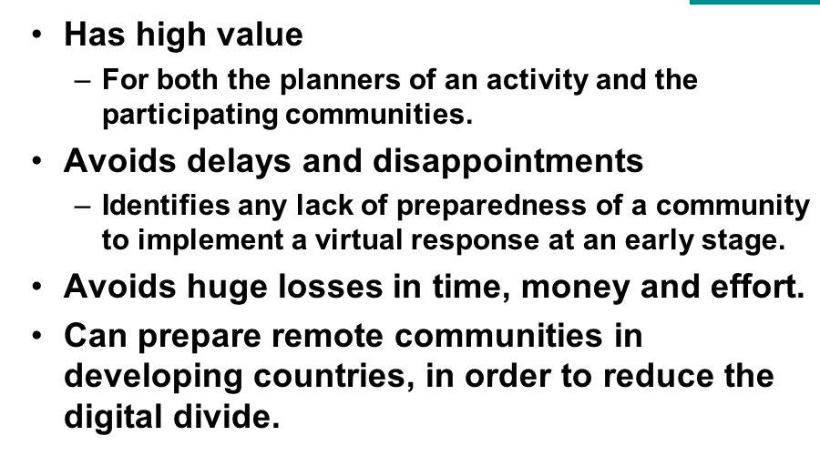
Fundamentals of e-Readiness

Slide 4
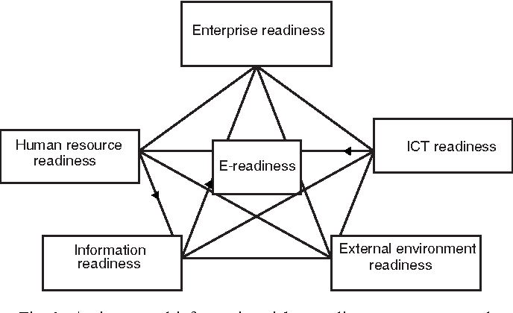
e-Readiness assessment techniques

